Slide 1
Introduction to R

Slide 2
What is R?
Programming language
Free, open source core, maintained and regularly updated
Statistics and data-focussed
Add-on packages made by users
NHPoisson
time
MASS
lmf
ade4
knitr
devtools
igraph
reshape2
faraway
stats
ggplot2
desolve
data.table
lubridate
matrixStats
network
dplyr
scales
R core

Slide 3
Why use R?
Free
Active development
No limit on what you can do:
Statistics
Data cleaning/processing
Interacting with websites
…

Slide 4
Overview of session and learning objectives
1. Objects
2. Data files
3. Plotting

Slide 5
Overview of session and learning objectives
1. Objects
2. Data files
3. Plotting
Familiarise yourself with:
RStudio
working directory
Execute statements for:
basic R functionality
built-in R functions
ask R for help with a function
Consider:
how to search for help online
Write code to:
explore basic R functionality
Execute statements for:
reading files
viewing data
manipulating data
Consider:
different ways to access the same information
how to trouble-shoot file read in issues
Write code:
to correct an issue
Execute statements for:
displaying data on a plot
personalising your plot e.g. colour, axis labels, title
Consider:
different ways to plot data

Slide 6
Session 1: Set working directory
Open RStudio
Set your working directory to wherever you saved the folder of practicals:
Session → Set working directory → Choose directory
Then navigate to the right folder

Slide 7
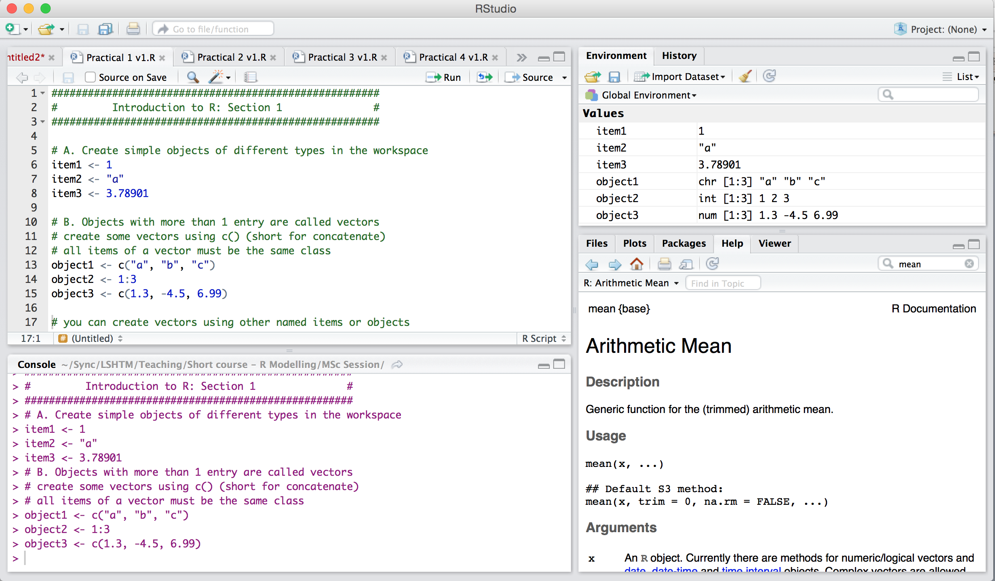
Session 1: RStudio
1. Script Window
4.Environment
3. Help and Plots
2. Console Window

Slide 8
Script window
Can have multiple R files open in tabs

Slide 9
# marks a commented line
When sent to console, does not get run
RStudio shows comments in a different colour
“Syntax highlighting”
RStudio shows R code in different colours according to what it is
Keep your script tidy:
- Space out sections
- Write useful comments

Slide 10
Console window
Where R code from the script window is run
Commands and results in same window
Ctrl+enter (Windows)

Slide 11
Help, Plotting, packages
Use different tabs depending on what you need

Slide 12
Objects in your environment, and history of commands run.
Use different tabs depending on what you need

Slide 13
Session 1: Running / executing
Running lines of code from script window
Buttons – “Run” at the top of script window
Shortcut – Ctrl + Enter (Windows); Cmd + Enter (Mac)
Run single lines or multiple lines

Slide 14
Session 1: Creating objects
Create objects in the workspace, or read them in from files using the “assignment operator”: <-
my.object <- “orange”
this.object <- c(1, 2, 3)
Then these objects exist in the workspace.
Check for them by looking in the environment tab
Or running the command: objects()

Slide 15
Session 1: Creating objects
object1 <- 546.32
object1 <- “orange”
Objects:
Single items (atomic)
Vectors
Access elements of vectors
object1 <- c(1.15, 2.33, 3.84)
object1[2]

Slide 16
Session 1: Creating objects
Set the first column to be a vector of numbers
Use this function to define a data frame
Objects:
Single items (atomic)
Vectors
Access elements of vectors
Data frames
Access elements of data frames by row and column
df1 <- data.frame(col1=c(1,2,3),
col2=c(“cat”, “dog”, “bear”) )
Second column a vector of names
Column names
col1 | col2
1 | “cat”
2 | “dog”
3 | “bear”
Row
Column
df1[3, 2]

Slide 17
Session 1: Creating objects
Objects:
Single items (atomic)
Vectors
Access elements of vectors
Data frames
Access elements of data frames by row and column
Matrices
Similar to data frames
(key difference in practical!)
Access elements of matrices in the same way
Lists

Slide 18
Session 1: Classes of objects
Objects are of certain types, called classes:
Character: “a”, “dog”, “orange”
Integer: 1, 2, 658, -32
Numeric: 1.2, 3.141592653, -2.1x10⁻⁴
Logical: TRUE/FALSE
Date: “2015-07-25” NAs are missing values and can be of any type

Slide 19
Session 1: Operations
Operations:
+, -, *, /
In built statistical functions
Mean, median, log, etc
Manipulating data sets
Extracting certain columns
Subsetting by value
Replacing values

Slide 20
Session 1. Finding help
Finding help
From the console:
“?” if you know the name of the function you’re looking for: ?mean
“??” to search for something: ??mean
In R Studio:
In the “Help” tab
Search box on the upper right
Online:
Stackoverflow is a question-and-answer website
Lots of error messages explained

Slide 21
Session 1: Practical
Use the R script called `Practical_P01_1.R`
Work through it, instructions are in comments:
# this is a comment
Enter answers, where it says “Answer:” as a comment
Save these scripts so you can refer to them later

Slide 22
Session 1: Summary
We’ve:
Created objects of different types
Performed operations on those objects
Extracted elements of data frames and matrices
Created new objects by subsetting

Slide 23
Session 2: Data files
Common data file types: .txt .csv (NB: need ‘packages’ to read in .dta .xls etc.)
Common delimiters: tab (“\t”), space (“ ”), comma (“,”)
Common read in functions: read.table(…), read.csv(…)
Some function options: - delimiter e.g. sep=“ ”
- column names e.g. header=TRUE
Example: mydata <- read.table(“mydatafile.txt”, header=FALSE, sep=“\t”)
Outputting data to check examples:
- All data: mydata
- First few lines of data: head(mydata)
- Column names: colnames(mydata)
- Dimensions of data: dim(mydata)

Slide 24
Session 2: Data files
Data read in as data.frame
Access columns via
- number e.g. important.column <- mydata[,3] # access third column
Country | Year | Incidence | Deaths
UK | 1970 | 1 | 0
UK | 1980 | 6 | 0
UK | 1990 | 34 | 3
France | 1970 | 32 | 4
France | 1980 | 17 | 2
France | 1990 | 12 | 0
Belgium | 1970 | 5 | 0
… | … | … | …

Slide 25
Session 2: Data files
Data read in as data.frame
Access columns via
- number e.g. important.column <- mydata[,3] # access third column
- names e.g. incidence <- mydata$Incidence # access incidence column incidence <- mydata[,”Incidence”]
Country | Year | Incidence | Deaths
UK | 1970 | 1 | 0
UK | 1980 | 6 | 0
UK | 1990 | 34 | 3
France | 1970 | 32 | 4
France | 1980 | 17 | 2
France | 1990 | 12 | 0
Belgium | 1970 | 5 | 0
… | … | … | …

Slide 26
Session 2: Data files
More on indexing / slicing / subsetting:
Country | Year | Incidence | Deaths
UK | 1970 | 1 | 0
UK | 1980 | 6 | 0
UK | 1990 | 34 | 3
France | 1970 | 32 | 4
France | 1980 | 17 | 2
France | 1990 | 12 | 0
Belgium | 1970 | 5 | 0
… | … | … | …
1) If you know row and/or column location
e.g. mydata[1,4] # 1st row 4th column
mydata$Incidence[5] # 5th row of ‘Incidence’

Slide 27
Session 2: Data files
More on indexing / slicing / subsetting:
Country | Year | Incidence | Deaths
UK | 1970 | 1 | 0
UK | 1980 | 6 | 0
UK | 1990 | 34 | 3
France | 1970 | 32 | 4
France | 1980 | 17 | 2
France | 1990 | 12 | 0
Belgium | 1970 | 5 | 0
… | … | … | …
1) If you know row and/or column location
e.g. mydata[1,4] # 1st row 4th column
mydata$Incidence[5] # 5th row of ‘Incidence’

Slide 28
Session 2: Data files
More on indexing / slicing / subsetting:
Country | Year | Incidence | Deaths
UK | 1970 | 1 | 0
UK | 1980 | 6 | 0
UK | 1990 | 34 | 3
France | 1970 | 32 | 4
France | 1980 | 17 | 2
France | 1990 | 12 | 0
Belgium | 1970 | 5 | 0
… | … | … | …
1) If you know row and/or column location
e.g. mydata[1,4] # 1st row 4th column
mydata$Incidence[5] # 5th row of ‘Incidence’

Slide 29
Session 2: Data files
More on indexing / slicing / subsetting:
Country | Year | Incidence | Deaths
UK | 1970 | 1 | 0
UK | 1980 | 6 | 0
UK | 1990 | 34 | 3
France | 1970 | 32 | 4
France | 1980 | 17 | 2
France | 1990 | 12 | 0
Belgium | 1970 | 5 | 0
… | … | … | …
1) If you know row and/or column location
e.g. mydata[1,4] # 1st row 4th column
mydata$Incidence[5] # 5th row of ‘Incidence’
2) If you know value in row and/or column but not location
e.g. mydata[mydata$Country==“UK”,]
# rows with column is equal to ‘UK’
mydata[(mydata$Country==“UK” & (mydata$Year<1985), ]
# UK data prior to 1985

Slide 30
Session 2: Data files
More on indexing / slicing / subsetting:
Country | Year | Incidence | Deaths
UK | 1970 | 1 | 0
UK | 1980 | 6 | 0
UK | 1990 | 34 | 3
France | 1970 | 32 | 4
France | 1980 | 17 | 2
France | 1990 | 12 | 0
Belgium | 1970 | 5 | 0
… | … | … | …
1) If you know row and/or column location
e.g. mydata[1,4] # 1st row 4th column
mydata$Incidence[5] # 5th row of ‘Incidence’
2) If you know value in row and/or column but not location
e.g. mydata[mydata$Country==“UK”,]
# rows with column is equal to ‘UK’
mydata[(mydata$Country==“UK” & (mydata$Year<1985), ]
# UK data prior to 1985

Slide 31
Session 2: Data files
More on indexing / slicing / subsetting:
Country | Year | Incidence | Deaths
UK | 1970 | 1 | 0
UK | 1980 | 6 | 0
UK | 1990 | 34 | 3
France | 1970 | 32 | 4
France | 1980 | 17 | 2
France | 1990 | 12 | 0
Belgium | 1970 | 5 | 0
… | … | … | …
1) If you know row and/or column location
e.g. mydata[1,4] # 1st row 4th column
mydata$Incidence[5] # 5th row of ‘Incidence’
2) If you know value in row and/or column but not location
e.g. mydata[mydata$Country==“UK”,]
# rows with column is equal to ‘UK’
mydata[(mydata$Country==“UK” & (mydata$Year<1985), ]
# UK data prior to 1985

Slide 32
Session 2: Data files
Over to you …
Open `Practical_P01_2.R` in Rstudio
GUIDANCE:
Write your answers next to #Answer:
Error fixing can depend on you doing two things
Fixing the code OR Fixing the data file itself

Slide 33
Session 2: Summary
What we’ve done:
- read in data files and saved them as data.frames
- stored additional columns in the data.frame
- accessed data from data.frame by location and by value
- used logical expressions (to find equality and to search data.frame by value)
- encountered (and solved) several common issues with data file reading

Slide 34
Session 3: Plots
Plot an x-y chart: plot(x=… y=…)
Add a title by adding an option to the plot: main=…
Add labels to the x and y axes: xlab=…, ylab=…
You find these options (and many more) by checking the help file for the plot you want
You can customise almost any aspect

Slide 35
Session 3: Histogram
Histograms are made using: hist(…)
Often the options are the same for different plot types,
e.g. title: main=…
E.g.labels to the x and y axes: xlab=…, ylab=…
You find these options (and many more) by checking the help file

Slide 36
Session 3: Multiple plots
Plot multiple charts of any type
Use: par(mfrow=c(1,2))
Multi-Figure ROW-wise
First number = number of rows
Second = number of columns
Then run your plotting code
Plot window remains in this layout until you change it

Slide 37
Session 3: Practical
Practical! (`Practical_P01_3.R`)
There are some advanced exercises at the end if you get there

Slide 38
Session 3: Summary
We’ve:
Made some basic plots
Learned how to change options to add titles and labels
Learned how to customise colours
Practiced adding more than 1 chart
Exported a figure

Slide 39
Take Homes
Take-away messages from this introduction:
Comment everything
Check each line of code is doing the right thing before writing more
Name variables sensible things e.g. IncidenceRate <- mydata[, 2] is better than A <- mydata[, 2]
If you are having a problem, other people will have had it too … Google / StackOverflow etc. are your friends

